Slide 1

SPOTIFY
SQL DATA ANALYSIS
DATA ANALYSIS PROJECT
Reya Mondal
Data Analyst SQL • Excel • Power BI
SQL DATA ANALYSIS | 2026

Slide 2
INTRODUCTION
Hello, I'm Reya Mondal
I am a Data Analyst with a strong interest in turning raw data into meaningful business insights. I work with SQL, Excel and Power BI to clean, analyze and present data in a clear and practical way.
PROFILE
CORE SKILLS
PROJECT FOCUS
Data Analyst Focused on analytical problem-solving
SQL • Excel • Power BI DAX • Power Query
Spotify SQL Data Analysis Data cleaning & business analysis
Goal: build reliable analysis and communicate insights clearly.
2

Slide 3
Project Overview
A SQL-driven exploration of Spotify track performance
BUSINESS GOAL
APPROACH
OUTPUT
Understand streaming performance, artist activity, album insights, engagement and platform preference.
Clean the dataset → validate fields → aggregate metrics → compare performance → extract insights.
10 business-oriented SQL analyses covering streams, artists, albums, audio features, views, likes and platform comparison.
3

Slide 4
Dataset & Table Structure
Main fields used in the analysis
Track & Artist
Audio Features
Engagement
artist • track • album • album_type
danceability • energy • loudness • speechiness • acousticness
views • likes • comments
Streaming
Video & License
Other Metrics
stream • most_played_on
licensed • official_video
tempo • duration_min • valence • liveness
4

Slide 5
Data Cleaning
Removing invalid duration records before analysis
1 CHECK ZERO-DURATION RECORDS
2 DELETE INVALID RECORDS
SELECT * FROM spotify WHERE duration_min = 0;
DELETE FROM spotify WHERE duration_min = 0;
QUALITY CHECK
Re-run the SELECT query after deletion to confirm that zero-duration records have been removed.
5

Slide 6
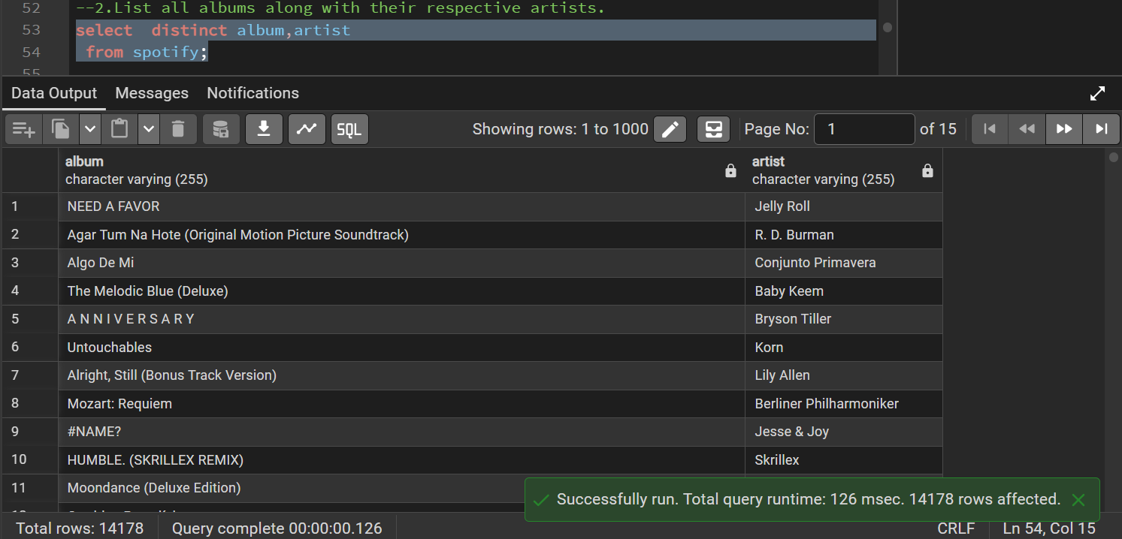
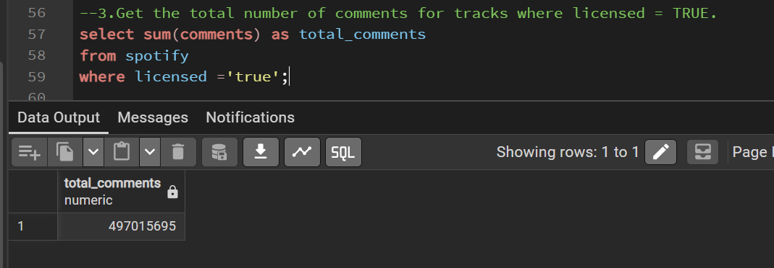
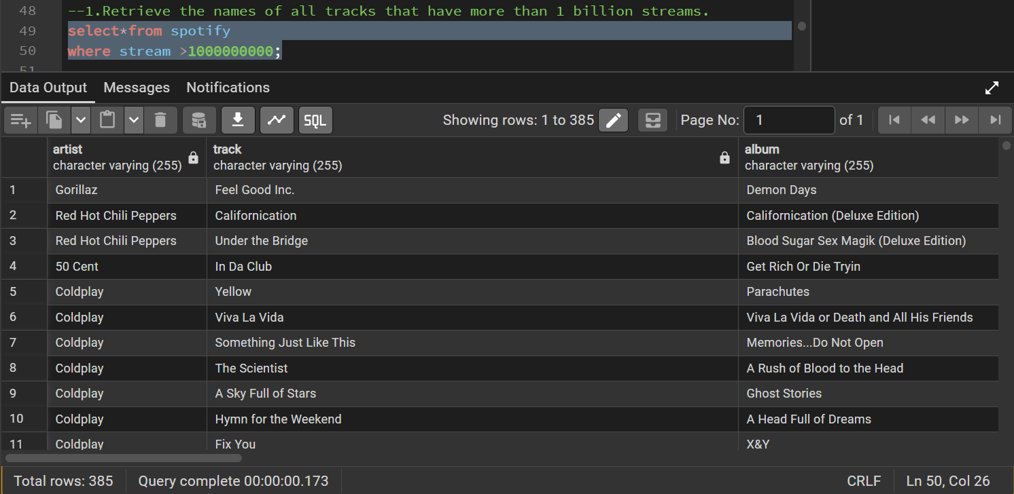
Analysis 1–3
Streaming, artist/album mapping and licensed engagement
01 • HIGH-STREAM TRACKS
02 • ALBUM + ARTIST
03 • LICENSED COMMENTS
SELECT * FROM spotify WHERE stream > 1000000000; Identifies tracks crossing the 1-billion-stream threshold.
SELECT DISTINCT album, artist FROM spotify; Creates a unique album–artist mapping.
SELECT SUM(comments) FROM spotify WHERE licensed = TRUE; Measures total comments for licensed tracks.
6

Slide 7
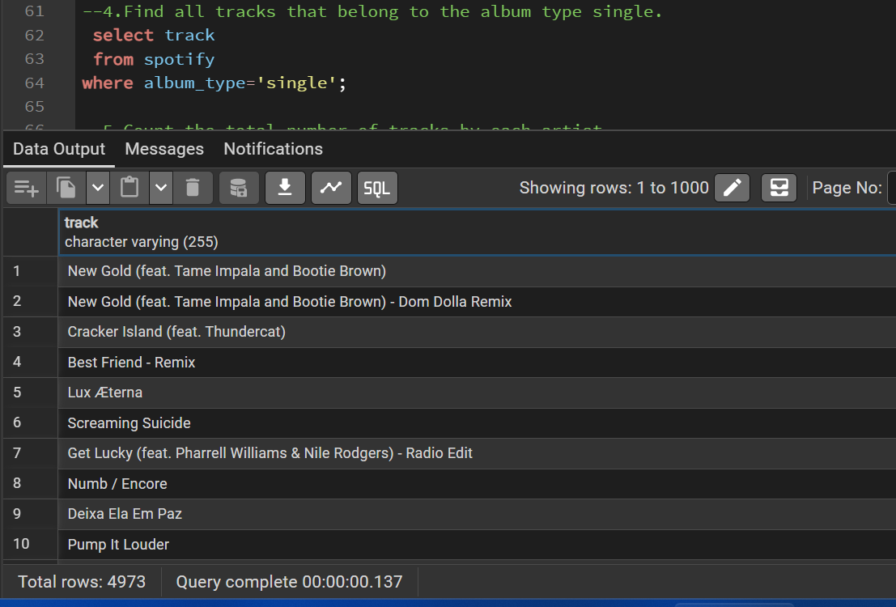
Result — Query 4
Count of total tracks by artist
04 • SINGLE TRACKS
SELECT track, album_type FROM spotify WHERE album_type = 'single'; Identifies tracks released as singles.
7

Slide 8
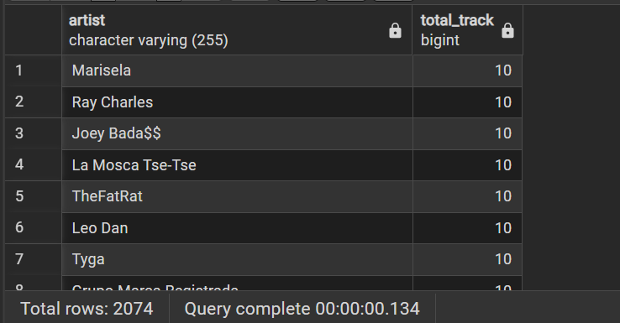
Analysis 5
Track type, artist volume and audio characteristics
The executed query returned 2,074 rows. The visible result shows artists such as Marisela, Ray Charles, Joey Bada$$, La Mosca Tse-Tse, TheFatRat, Leo Dan and Tyga with 10 tracks each.
RESULT
05 • TRACKS BY ARTIST
SELECT artist, COUNT(track) FROM spotify GROUP BY artist; Measures artist-level track volume.
8

Slide 9
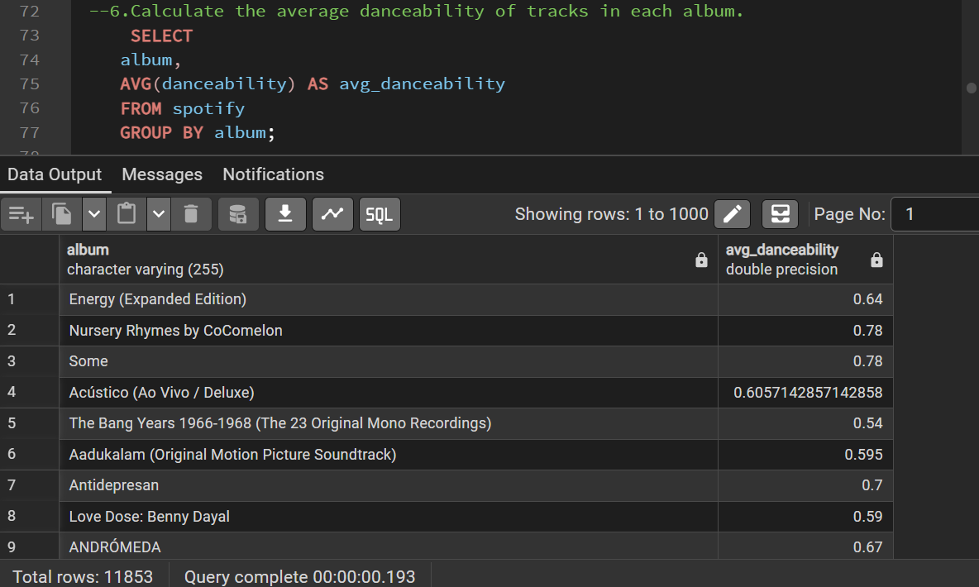
Result — Query 6
Average danceability of tracks in each album
06 • AVG DANCEABILITY
RESULT
The executed query returned 11,853 album-level rows. The visible results include Energy (Expanded Edition) at 0.64, Nursery Rhymes by CoComelon at 0.78, Some at 0.78 and Acústico (Ao Vivo / Deluxe) at approximately 0.606.
Evidence from executed SQL query
9

Slide 10
Analysis 7–9
Energy ranking, official video engagement and album views
07 • TOP 5 ENERGY
08 • OFFICIAL VIDEO
09 • ALBUM VIEWS
SELECT track, MAX(energy) FROM spotify GROUP BY track ORDER BY max_energy DESC LIMIT 5;
SELECT track, views, likes FROM spotify WHERE official_video = TRUE; Reviews video engagement metrics.
SELECT album, SUM(views) FROM spotify GROUP BY album ORDER BY total_views DESC; Ranks albums by total views.
10

Slide 11
Analysis 10 — Spotify vs YouTube
Conditional aggregation + HAVING
BUSINESS QUESTION
Which tracks have more Spotify streams than YouTube streams?
SQL LOGIC
SELECT track, COALESCE(SUM(CASE WHEN most_played_on='YouTube' THEN stream END),0) AS youtube_streams, COALESCE(SUM(CASE WHEN most_played_on='Spotify' THEN stream END),0) AS spotify_streams FROM spotify GROUP BY track HAVING COALESCE(SUM(CASE WHEN most_played_on='Spotify' THEN stream END),0) > COALESCE(SUM(CASE WHEN most_played_on='YouTube' THEN stream END),0);
11

Slide 12
SQL Concepts Demonstrated
Core techniques used throughout the project
01
02
03
04
SELECT / WHERE
DISTINCT
COUNT / SUM / AVG
GROUP BY
05
06
07
08
ORDER BY / LIMIT
CASE WHEN
COALESCE
HAVING
12

Slide 13
Key Analytical Takeaways
What this project demonstrates
Streaming
Identify high-performing tracks using stream thresholds.
Artists
Measure artist catalog volume with grouped counts.
Albums
Compare album-level danceability and total views.
Engagement
Use views, likes and comments as audience indicators.
Platforms
Use conditional aggregation to compare platform-labelled streams.
13

Slide 14
Project Workflow
End-to-end SQL analytics process
01
02
03
04
05
06
Raw CSV
SQL Table
Data Cleaning
SQL Queries
Aggregation
Insights
Raw data → clean data → SQL analysis → grouped metrics → business-ready insights
14

Slide 15
SQL EXECUTION RESULTS
Actual PostgreSQL output screenshots added as project evidence
QUERY 5
QUERY 6
PROJECT VALUE
2,074 result rows Track count grouped by artist
11,853 result rows Average danceability grouped by album
Shows both the SQL logic and the executed database output
Use these result slides in your portfolio presentation to demonstrate that the SQL queries were actually executed.
15

Slide 16
THANK YOU
Spotify SQL Data Analysis
SQL • Data Cleaning • Data Analysis • Business Insights
Reya Mondal

